Slide 1
GAME playing

Slide 2
Q1: Can a computer play?
Q2: If yes, how good is it in playing?
Q3: Can it learn?

Slide 3
INTRODUCTION
Idea: Originated since Charles Babbage, 19th century.
In 1950, Claude Shannon wrote a paper which describe mechanisms that could be used in a program to play chess.
Alan Turing described a chess-playing program but not implemented.
1960s, Arthur and Samuel built checkers successfully, it could learn n improve.

Slide 4
Generate and test procedure for games
Generator: For a good searching technique, a generator which can generate only the good moves is required.
Tester: Similarly, a tester which can give the best path (move) is favorable.
Example: Chess
Generator: Use a plausible-move generator (which can generate only some promising moves ) rather than a legal-move generator(which can generate all possible legal moves). However, using only the generator is not enough, a heuristic function can be used to produce only some good moves.
Tester: Apply some heuristic function to choose a better path among those paths which are generated by the generator.

Slide 5
Static evaluation function
It is similar to h’ of A* algorithm.
Example:
In Chess, it helps to choose the board position which is more advantageous.
Turing proposed a static evaluation function based on piece advantage and is given by the formula :
W/B
where, W= values of black pieces and B= values of white pieces.
However, a better function was proposed by Samuel for checkers.

Slide 6
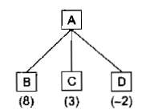
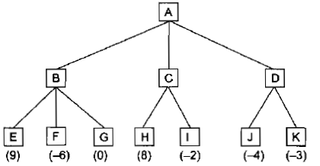
Minimax Search procedure
Fig 1: One ply search
Fig 2: Two ply search
****In game theory, ply means move***

Slide 7
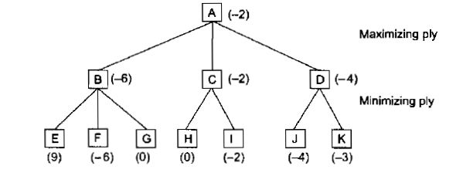
Fig 3: Backing up the values of a two ply search

Slide 8
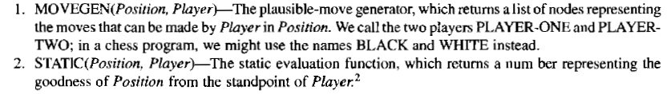
Sub-procedures

Slide 9
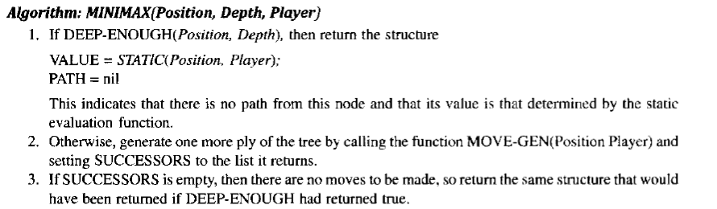
Algorithm

Slide 10
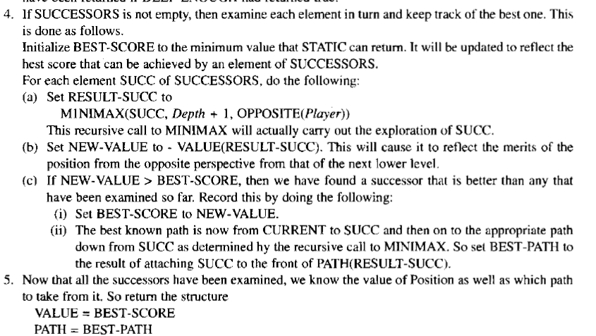
Algorithm contd…

Slide 11
ALPHA-BETA CUTOFFS
Two threshold values are used to prune the tree:
Alpha: lower bound on the value the maximizing node can be assigned.
Beta: upper bound on the value the minimizing node can be assigned.

Slide 12
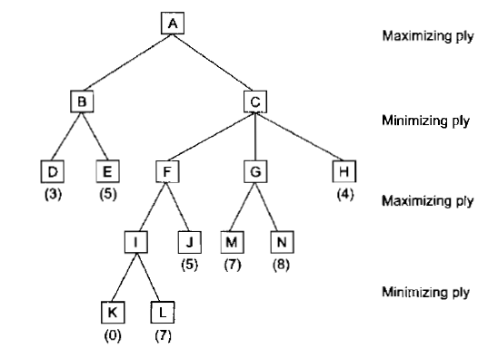
Example
Fig 6: Alpha and beta cut offs.
MAX
MIN
MAX
MIN
MAX

Slide 13
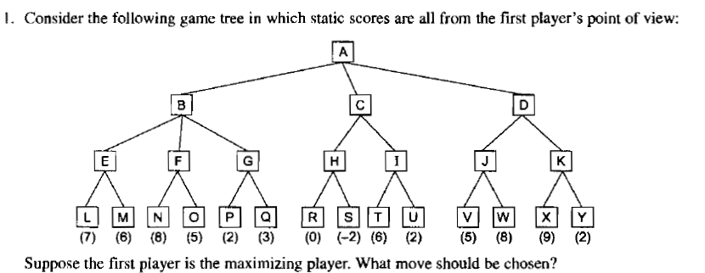
Exercises

